Slide 1
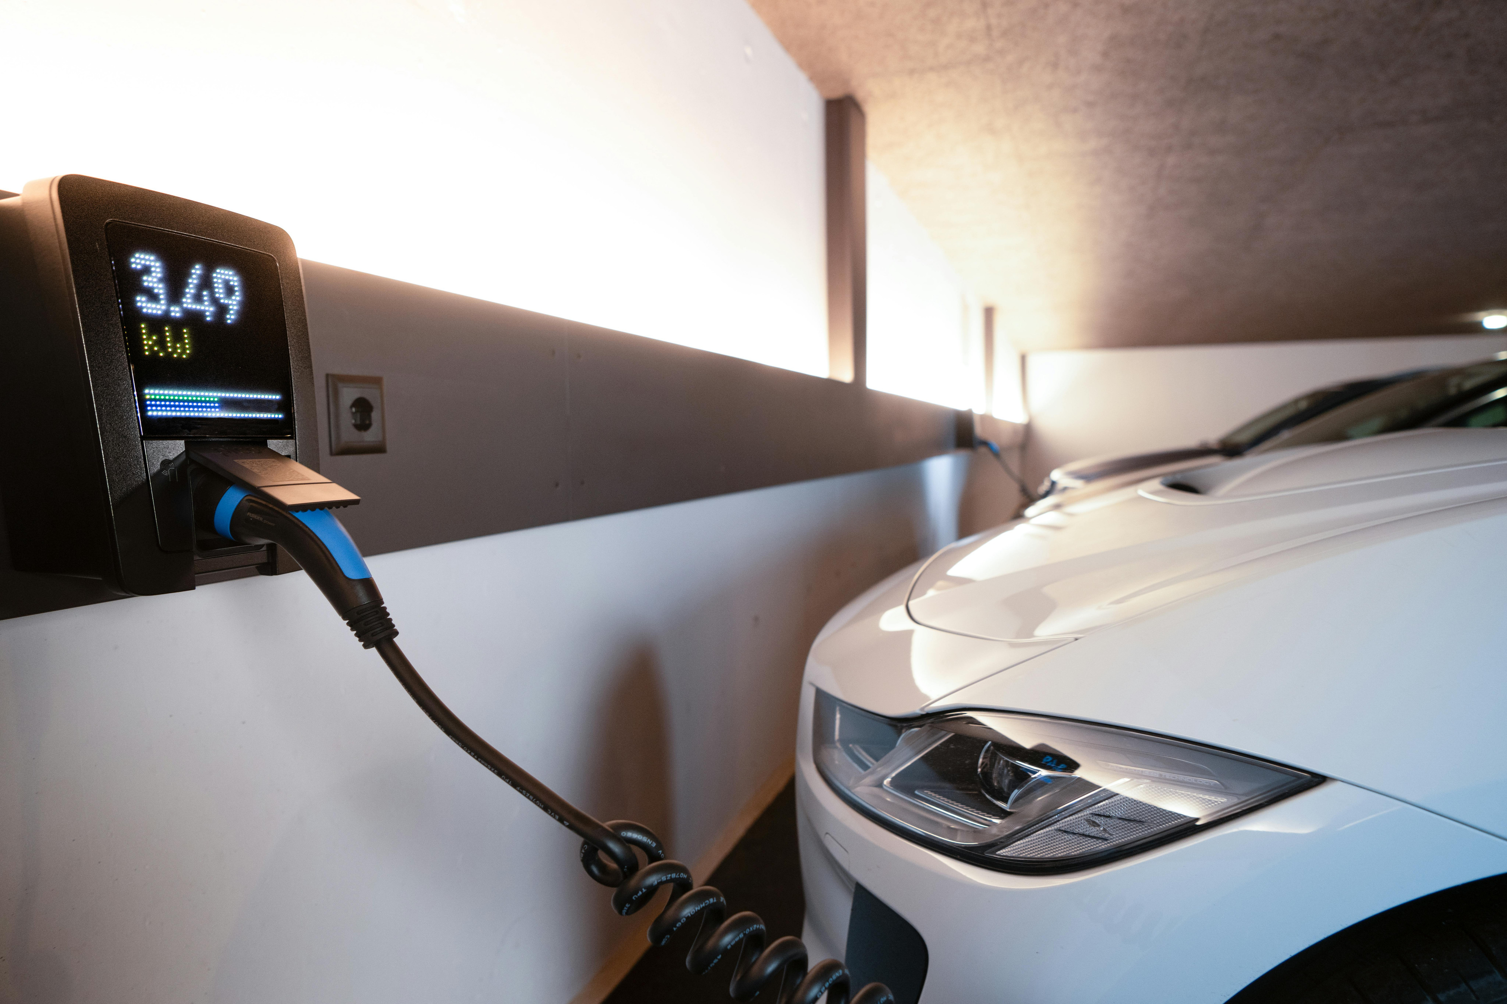


Rapid Velocity
DRIVING THE FUTURE OF SUSTAINABLE MOBILITY

Slide 2
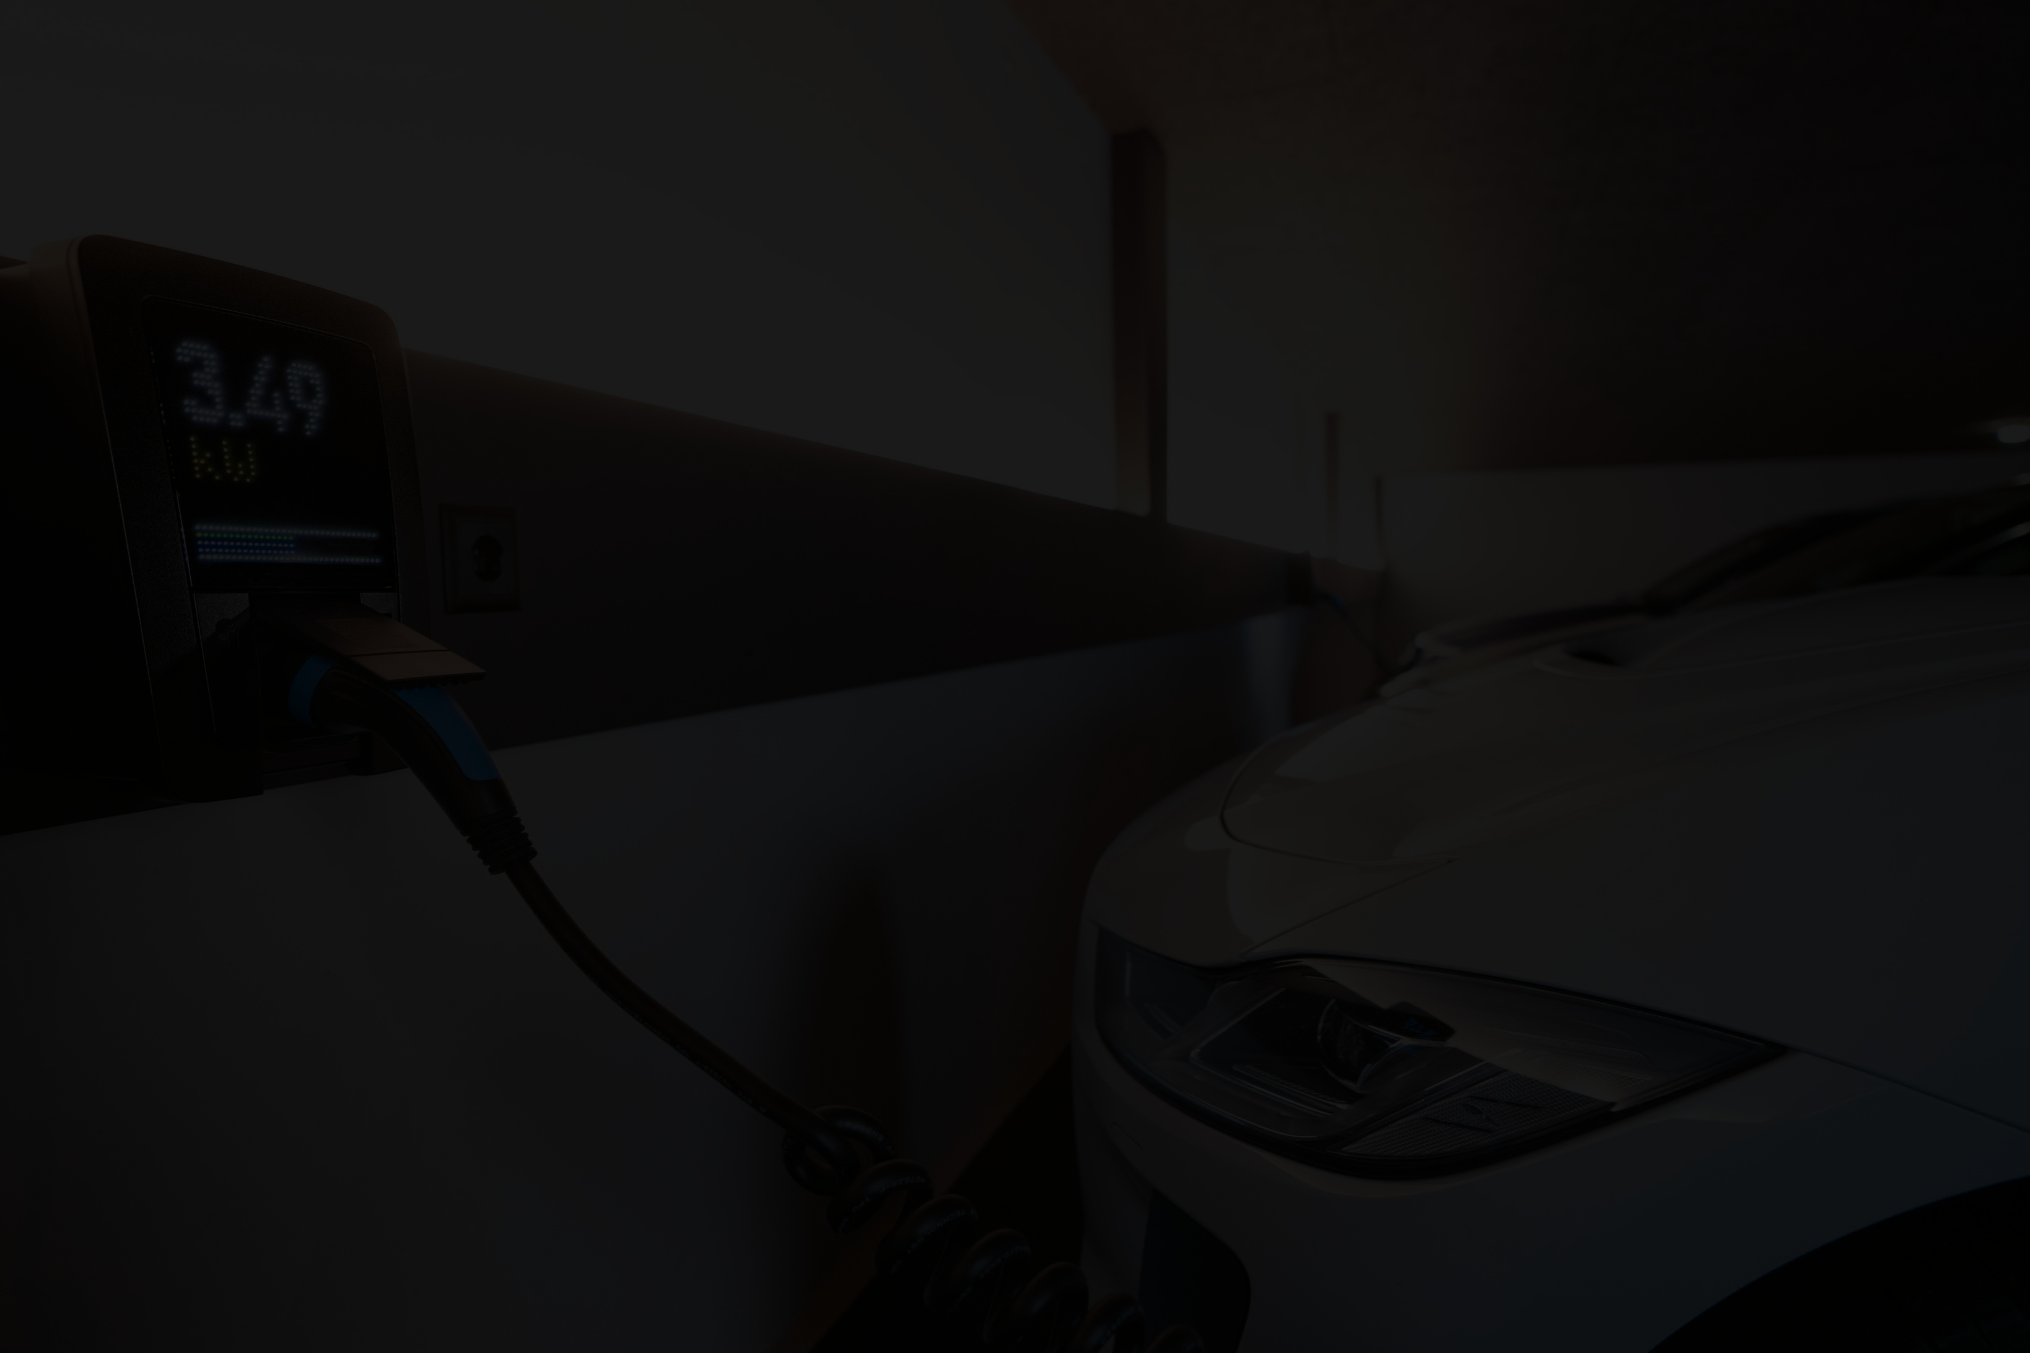
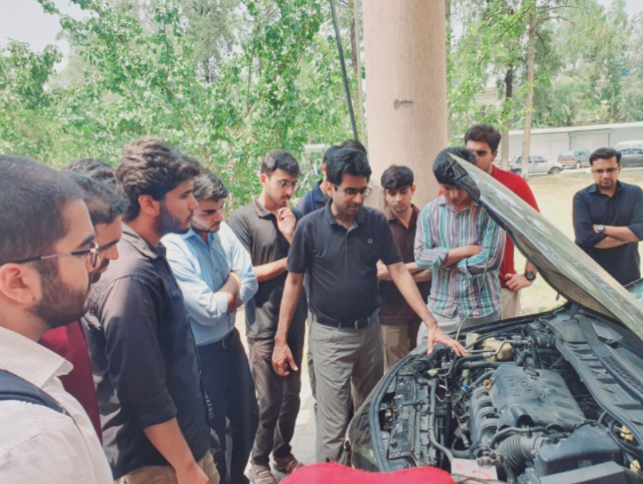
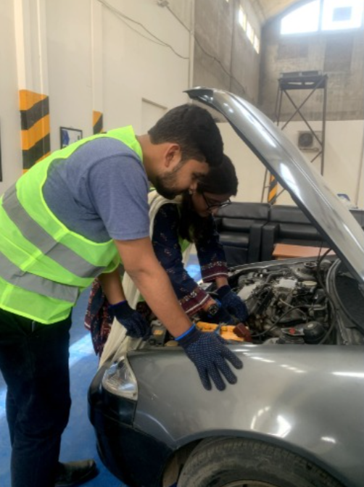
Company
Overview
Rapid Velocity is a Pakistan-based EV startup focused on making electric mobility accessible, practical, and locally developed.
We specialize in:
  ICE-to-EV Conversion
  Custom Battery Packs
  Commercial EV Solutions
  EV Training

Slide 3

A Problem- And a Growing Opportunity
•Rising transportation and fuel costs
•Dependance on imported fuel
•High upfront cost of new Evs
•Need for local EV expertise and technology

Slide 4
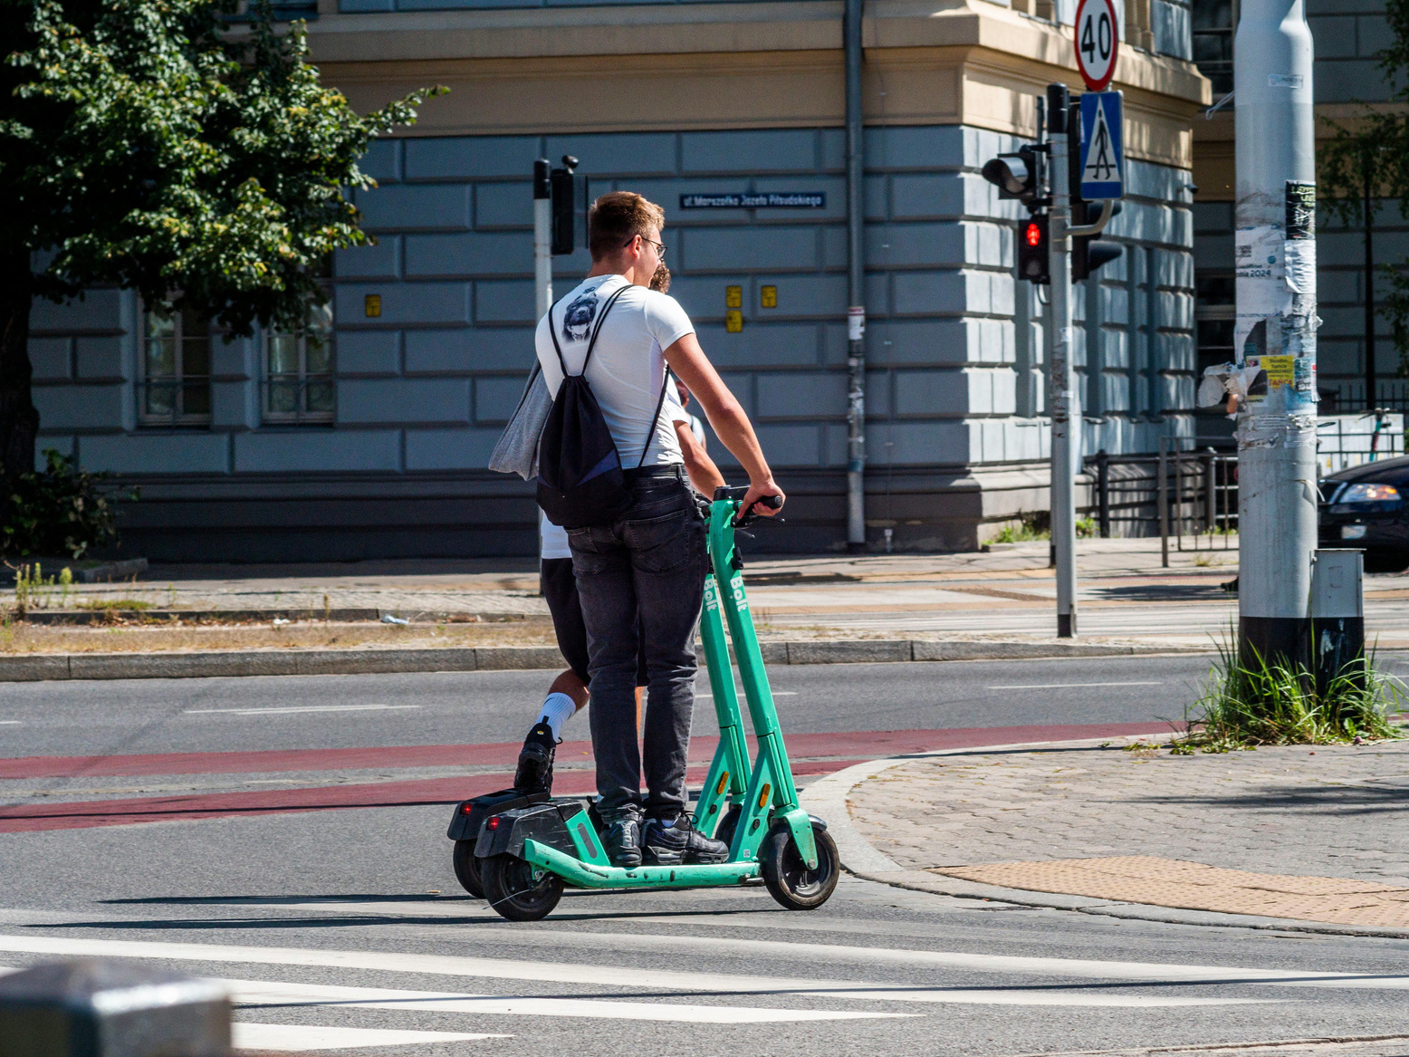
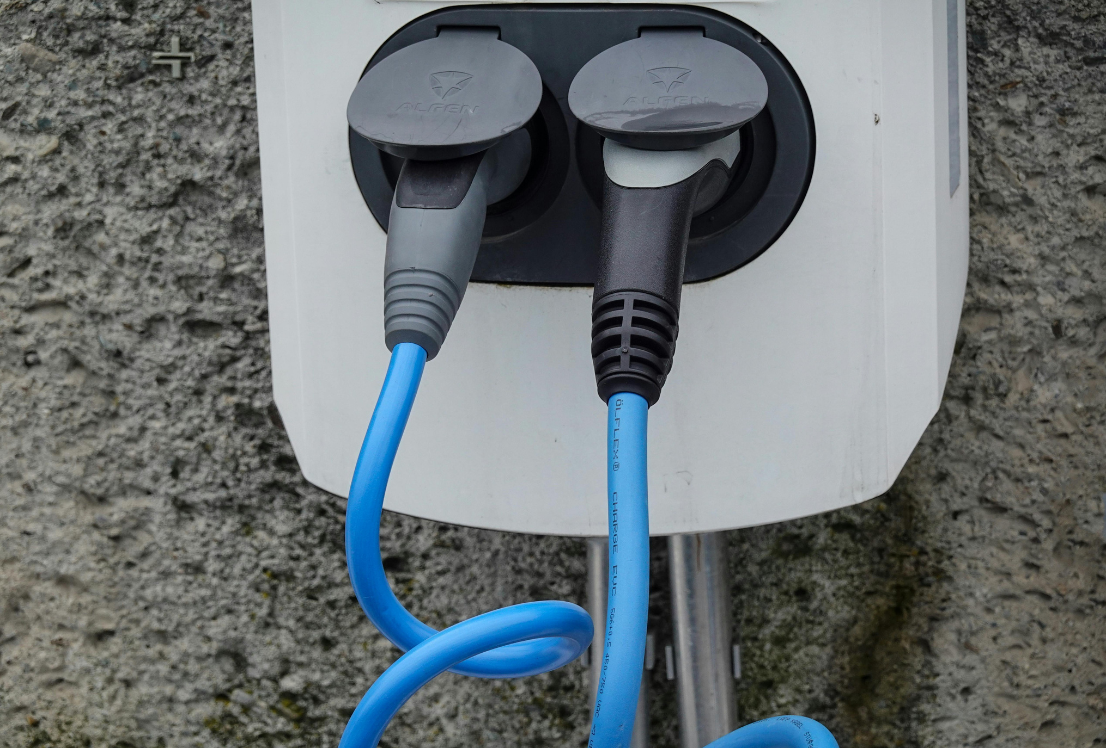
A Problem- And a Growing Opportunity
  Transport contributes about 10–11% of Pakistan's total greenhouse gas (GHG) emissions
  If looking only at CO₂ emissions, transport's share is much higher—around 28–30% of Pakistan's carbon dioxide emissions according to several studies

Slide 5
The policy direction
  30% of all new vehicle sales to be NEVs by 2030.
  50% of new vehicle sales to be NEVs by 2040.
  100% of new vehicle sales to be NEVs by 2050.
  100% Zero-Emission Vehicle (ZEV) fleet targeted by 2060.
  3,000 public charging stations planned nationwide by 2030.

Slide 6
Vision & Mission
“The Poor Man’s EV”
Affordable, Practical and Electric

Slide 7
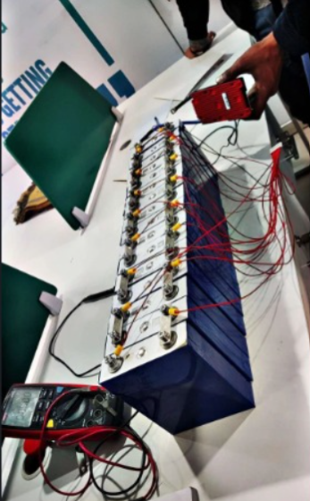
Our Journey: From Idea to Reality
  The Idea
  Learning & Experiementation
  First Conversion
  Testing in the Real Word

Slide 8
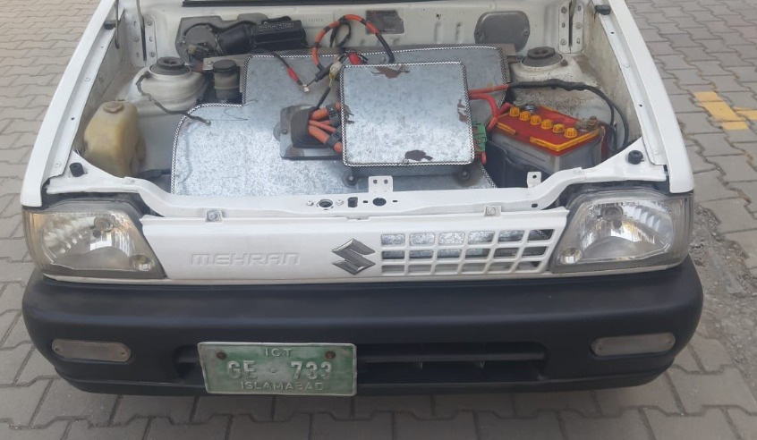
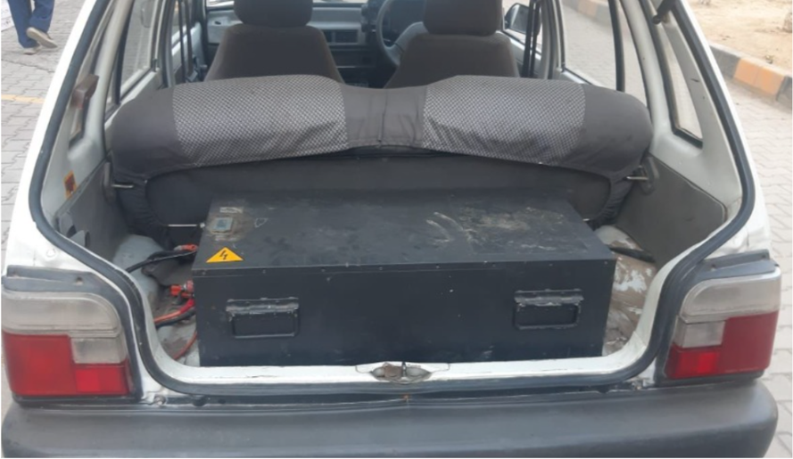
Our Product: Pakistan’s first EV suzuki mehran

Slide 9
The Roadblocks Behind Rapid Velocity
  High import taxes on EV components.
  Limited availability of EV parts in Pakistan.
  Technical difficulties during vehicle conversion.
  Budget and resource constraints.

Slide 10
Future Plans
  Swapable Batteries
  Sodium Batteries
  Vehicle to Grid
  G2G

Slide 11
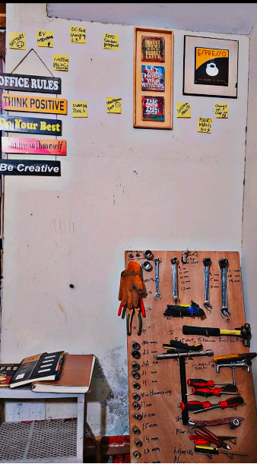
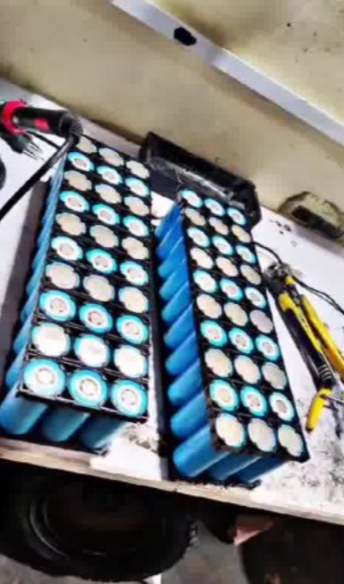
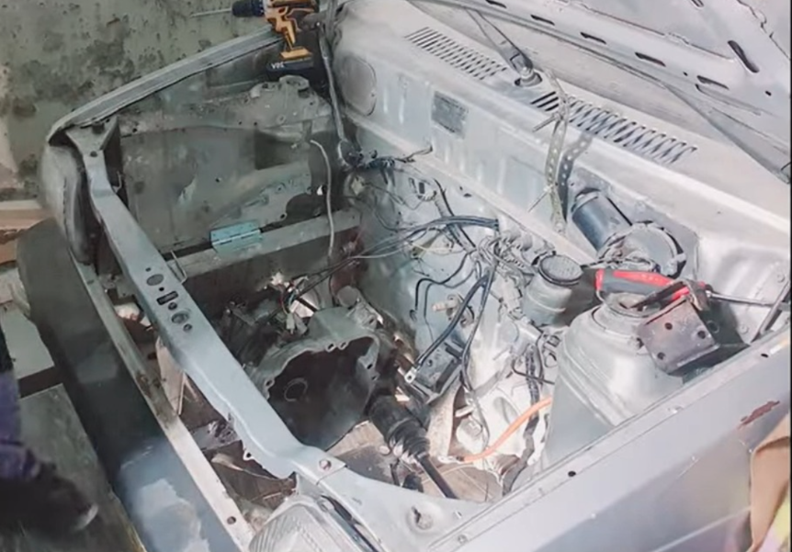
HiGHlIghts

Slide 12

Thynk Unlimited
thank
you

